Slide 1
KIARA & SEAN’S WEDDING
MAY 25TH, 2026
80 GUESTS
SHANGRI-LA, PARIS
WEDDING MOOD BOARD

Slide 2
COLOR PALETTE
MAY 25TH, 2026:
CEREMONY: WARM WHITE/GREENERY/LIGHT PINK
BOUQUET: WARM WHITE/LIGHT PINK
COCKTAIL & RECEPTION/DINNER: WARM WHITE/LIGHT PINK
WELCOME PARTY: WARMWHITE/GREENERY/LIGHT PINK

Slide 3
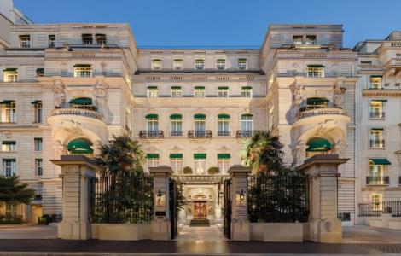
CEREMONY DECOR
The ceremony will take place at Shangri-La, Paris.

Slide 4
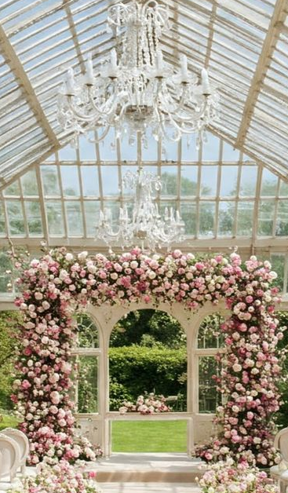
CEREMONY DECOR – OPTION 1
A rectangular floral arch will be adorned with a refined mix of warm white and light pink spring florals, complemented by subtle touches of greenery

Slide 5
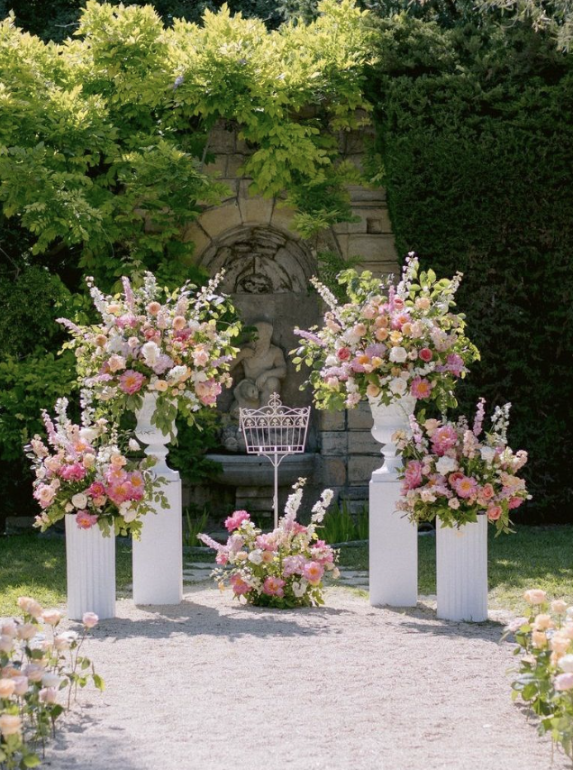
CEREMONY DECOR – OPTION 2
This 2nd ceremony décor option features 4 white columns in 2 varying heights, each adorned with soft pink, blush, peach, and warm white spring florals, accented with light greenery. The columns will be placed on each side of the bride and groom, as shown in the reference image.

Slide 6
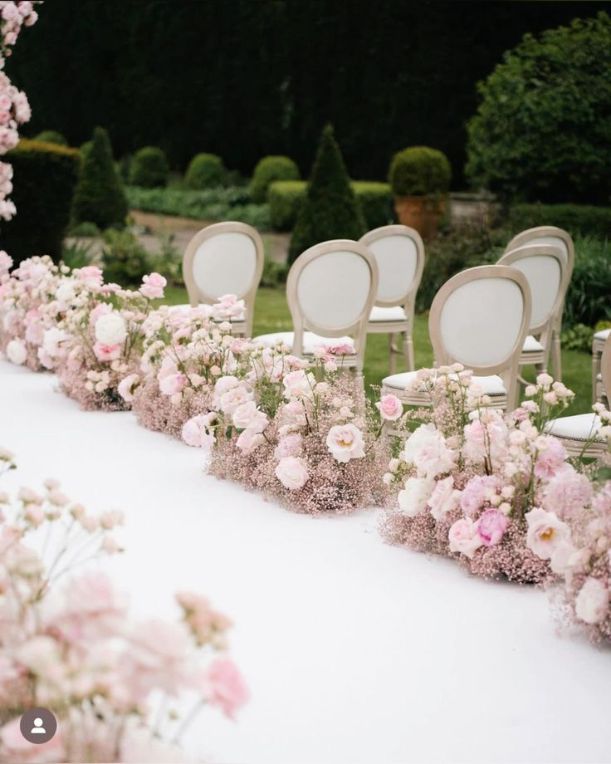
AISLE DECOR
Individual medium-sized rectangular floral arrangements (12 recommended — a minimum of 6 on each side), composed of seasonal blooms in warm white florals accented with subtle touches of light pink, as shown in the reference image. These arrangements will be artfully positioned along both sides of the aisle, creating an elegant and romantic pathway for the ceremony

Slide 7
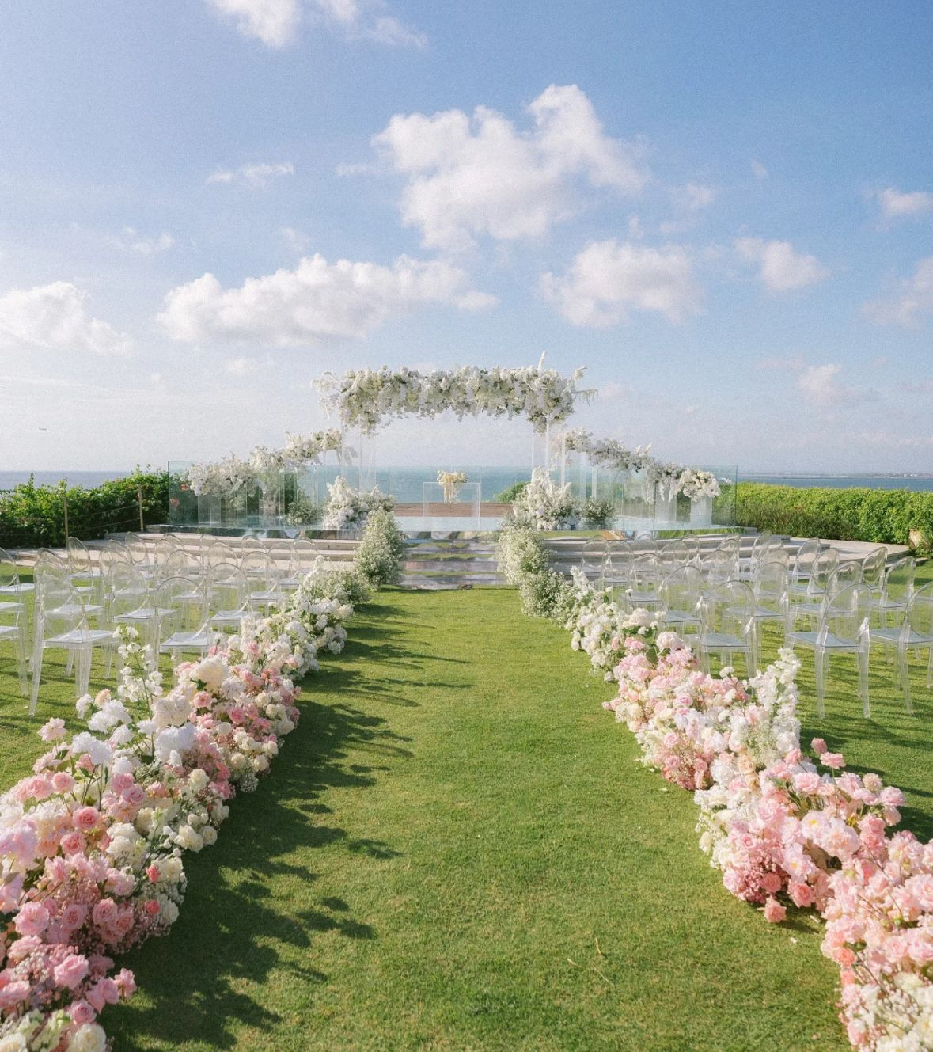
AISLE DECOR – OPTION 2
Lush greenery intertwined with seasonal white and soft pink florals will form garlands extending from side to side along both edges of the aisle, creating a romantic and immersive ceremony pathway

Slide 8
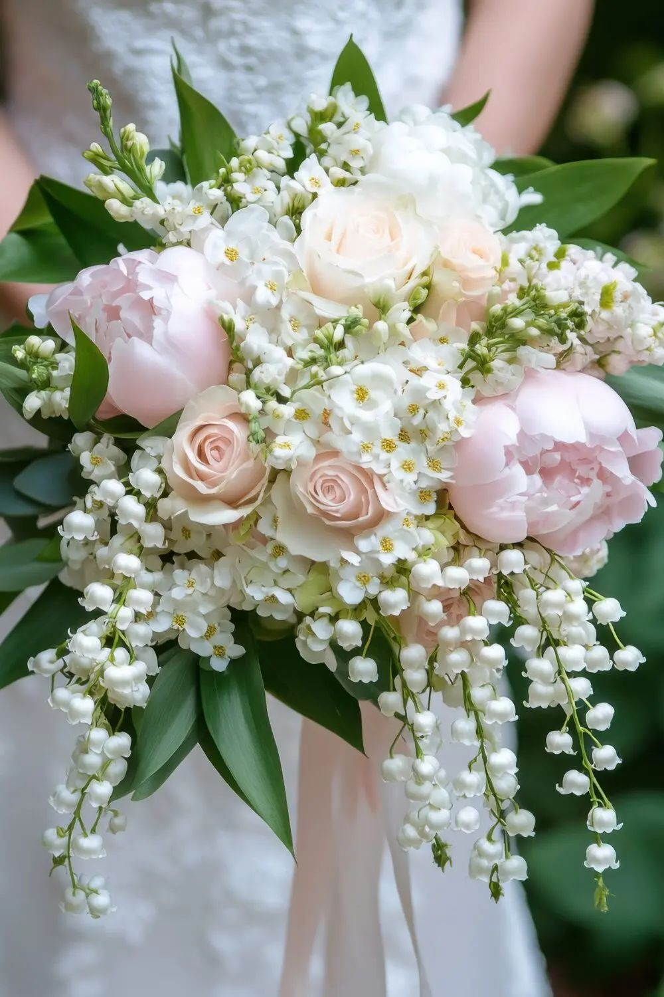
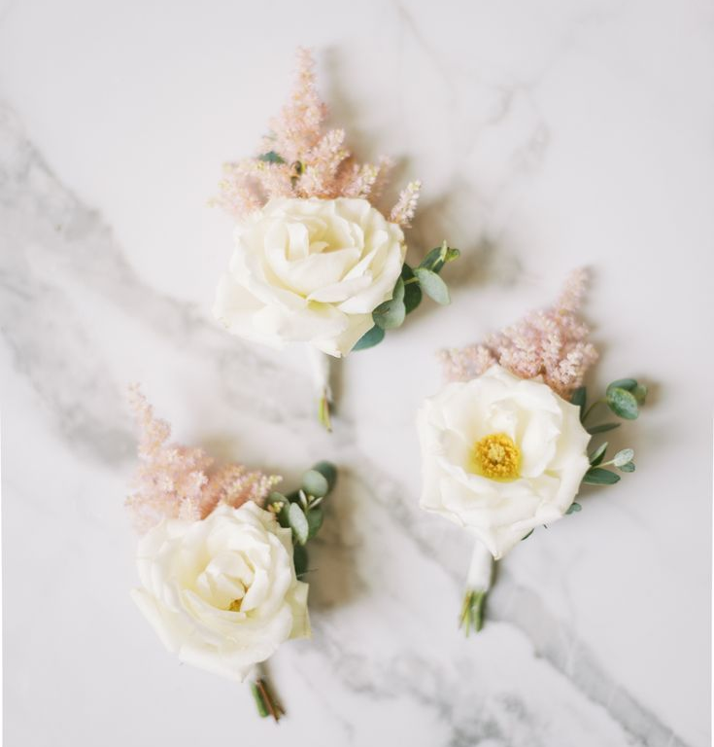
BRIDAL BOUQUET
Bridal bouquet: The bridal bouquet will be medium in size, composed of an airy and refined blend of warm white and light pink florals, inspired by the reference image. The stems will be finished with a flowing light pink ribbon, delicately tied and left partially exposed to create a natural, effortless finish
Boutonniere: The boutonniere will feature a wild spring bloom, delicately enhanced with a soft pastel accent

Slide 9
MAID OF HONOR & FLOWER GIRLS BOUQUETS
Should this be required, please inform us and include a reference image for guidance

Slide 10
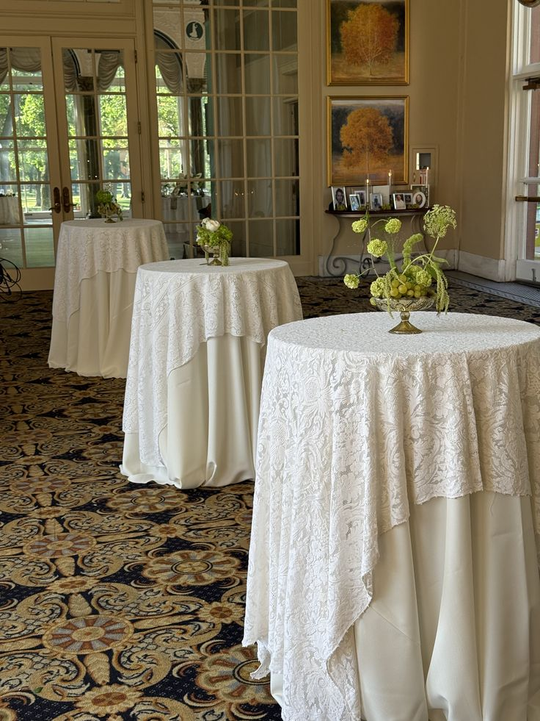
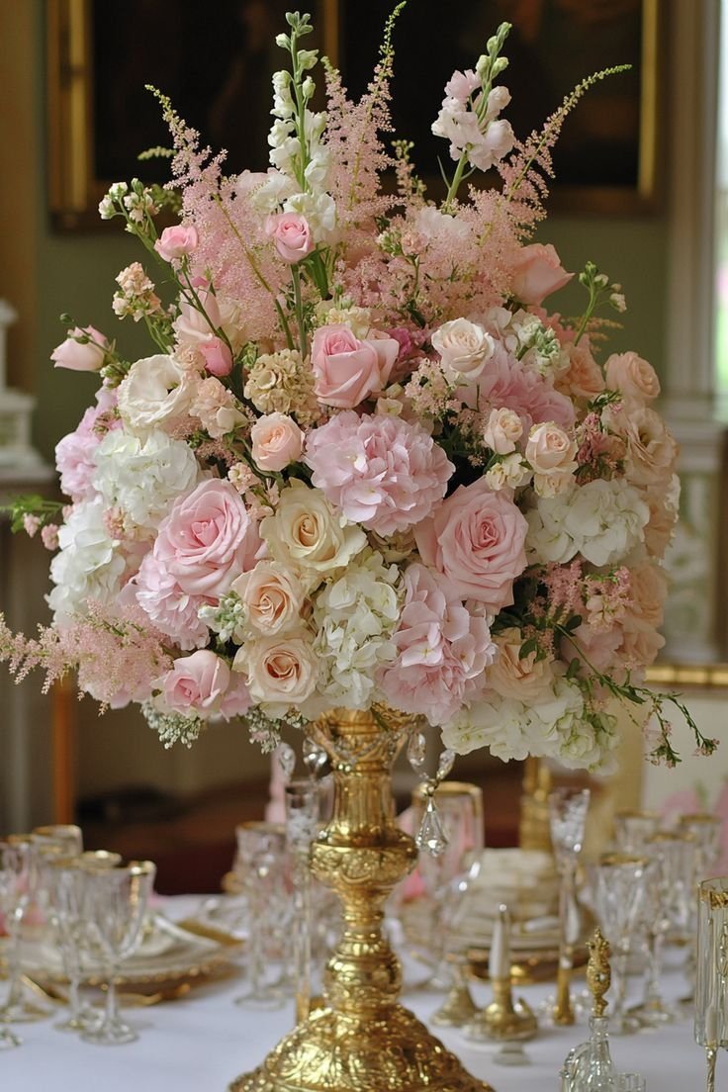
COCKTAIL
During the cocktail hour, a carefully curated arrangement of high-top cocktail tables, enhanced with elegant lace-style drapery cascading to the floor (or ivory polyester linens for a more economical option), will offer guests an inviting space to relax in an atmosphere of understated elegance
Each table will feature medium-sized, delicate floral arrangements in shades of warm white and light pink, presented in antique gold vases

Slide 11
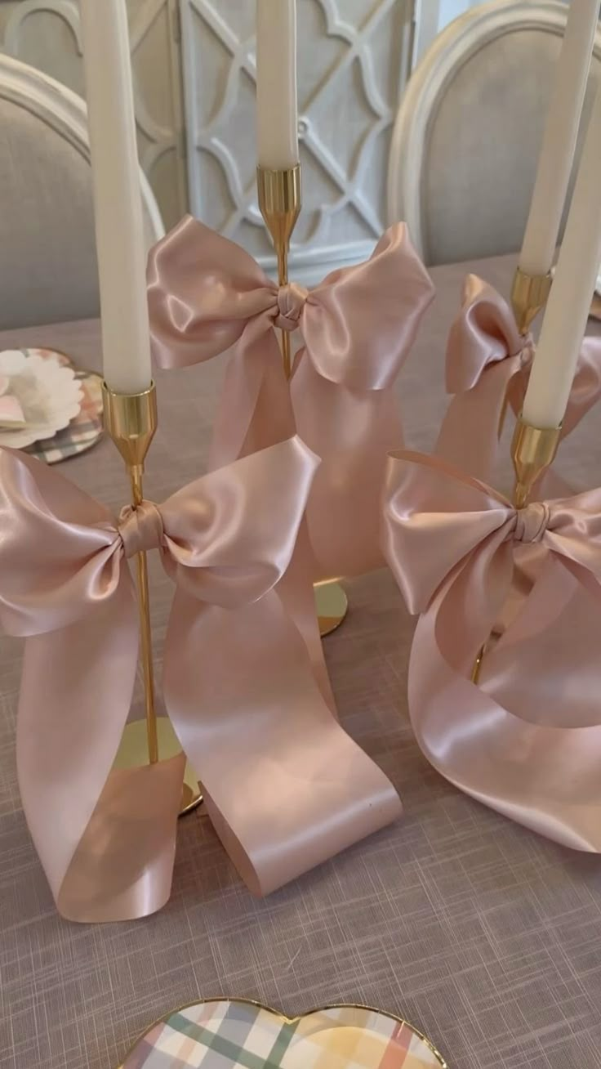
COCKTAIL – PART 2
A set of medium-sized candles, adorned with delicate light pink silk knots, will be displayed on short gold taper holders on each table

Slide 12
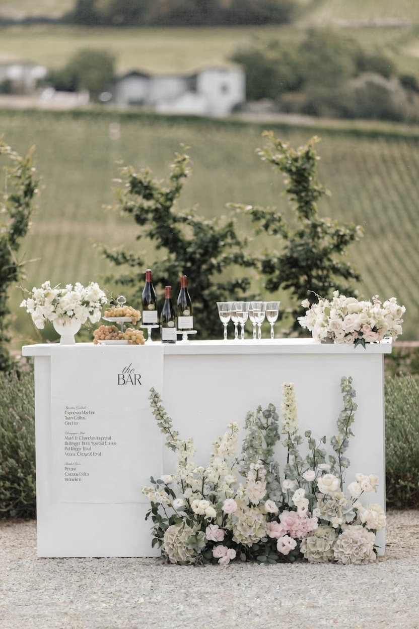
BARS DECOR
Bar will be provided by the Shangri-La for both cocktail & reception
A bespoke light pink banner will be thoughtfully designed and printed, elegantly displaying the selected beverages, the names of the bride and groom, and the wedding date
The décor will echo the reference imagery, styled in harmony with the color palette detailed on slide #2

Slide 13
SIGNS

Slide 14
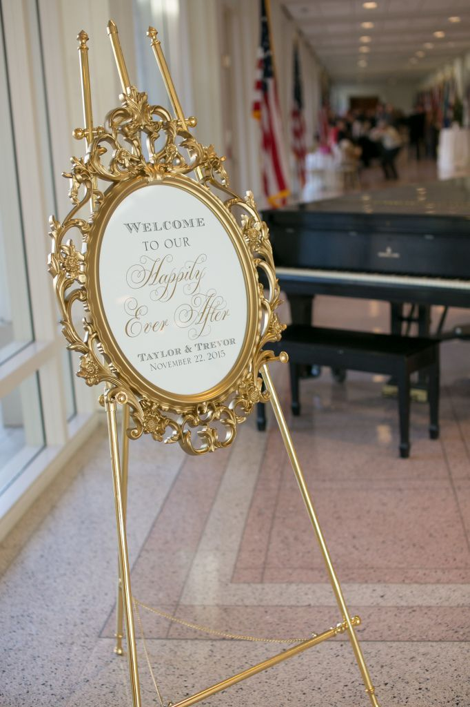
Welcome Sign & Décor
A Baroque-style gold mirror will showcase the bride and groom’s names in luminous gold script, paired with the wedding date in refined dark brown typography, exuding sophistication and timeless elegance
The gold frame will be a distinct variation from the reference image, providing a bespoke and sophisticated touch while preserving the overall elegance of the design

Slide 15
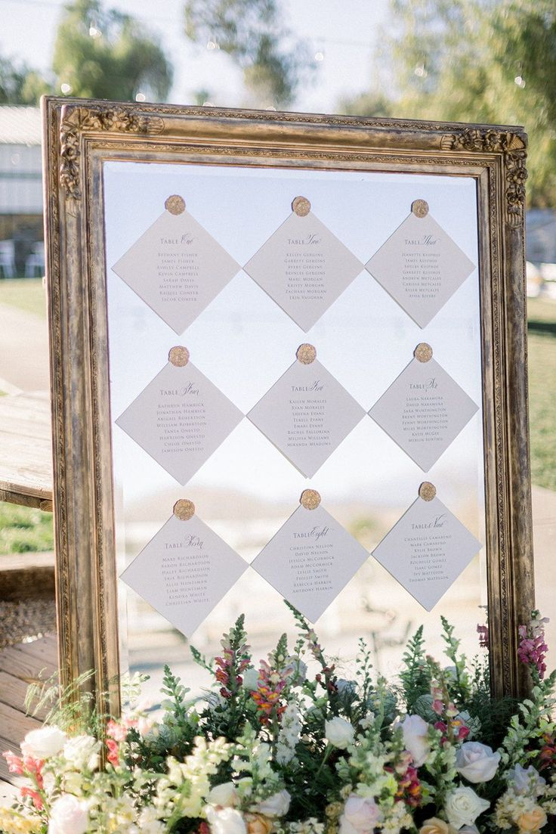
Seating Chart
A large rectangular gold-framed mirror will display the seating chart, featuring wax-sealed, gold-stamped cards elegantly presenting each table number and guests’ names
A medium-sized floral arrangement will be displayed at the base of the seating chart, with décor echoing the reference imagery and styled in harmony with the color palette detailed on slide #2

Slide 16
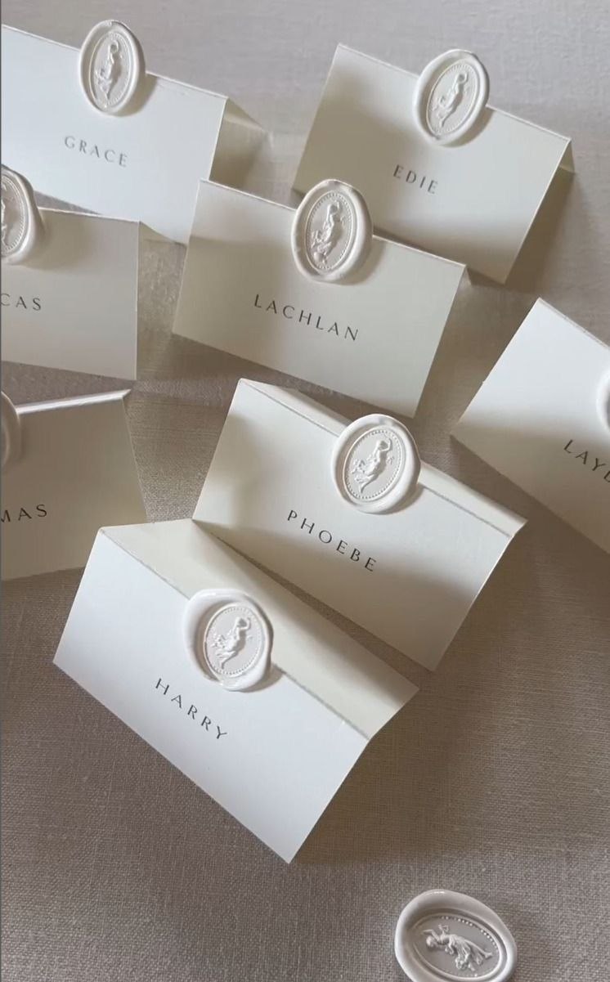
Place Cards
Audrey’s Note:
Please note that place cards are required by the catering staff regardless of round or rectangular tables. For weddings with more than 100 guests, place cards must be placed on each table with assigned seating, showing each guest’s full name, table number, and a meal icon/allergy note to guide the staff.

Slide 17
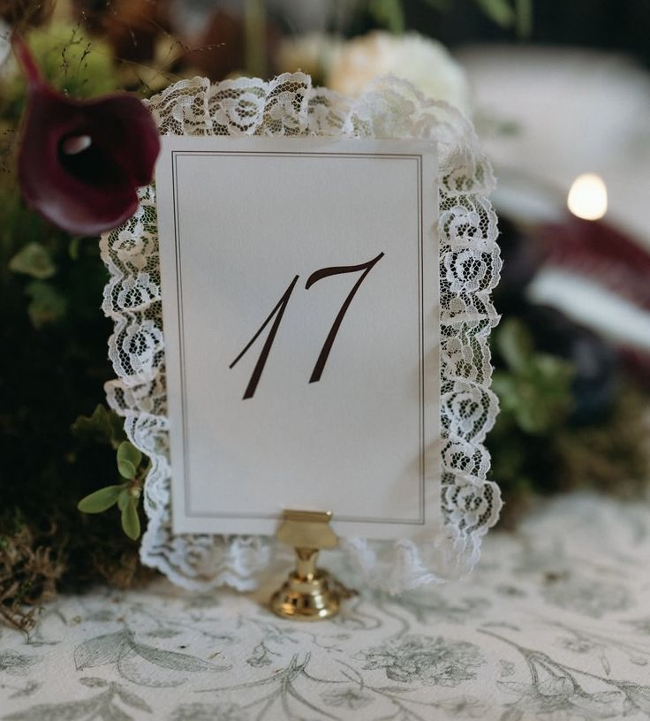
Table numbers
A sophisticated rectangular design, printed on warm white paper and enhanced with delicate lace detailing and elegant script typography, will be gracefully displayed on a gold holder, exuding understated elegance

Slide 18
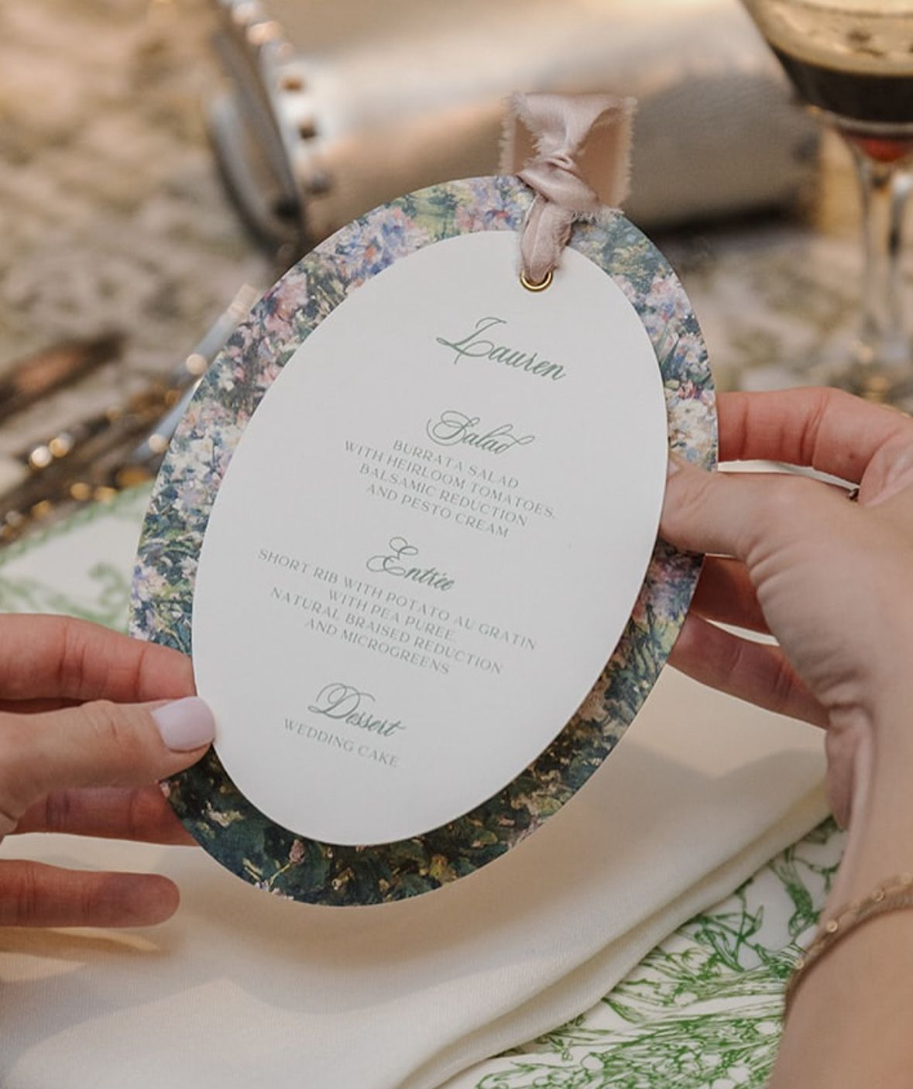
Menus
An oval-format menu, adorned with a delicate light background card beneath and featuring elegant dark green script typography at its center, accented with a light pink ribbon, exuding refined and harmonious sophistication
Audrey’s note: For the menu the Bride would like something with a more simple background paper vs the busy floral design.

Slide 19
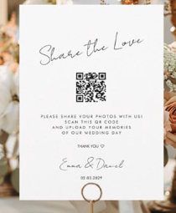
QR Code Sign
Simple aesthetic as picture

Slide 20
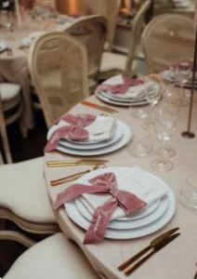
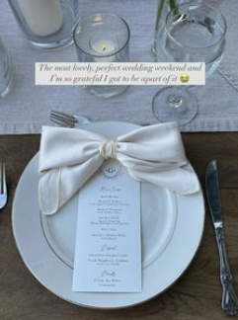
Satin bows on plates
as picture – Light Pink color is recommended to match best with the decor

Slide 21
RECEPTION DÉCOR
The ceremony will take place at Shangri-La, Paris.

Slide 22
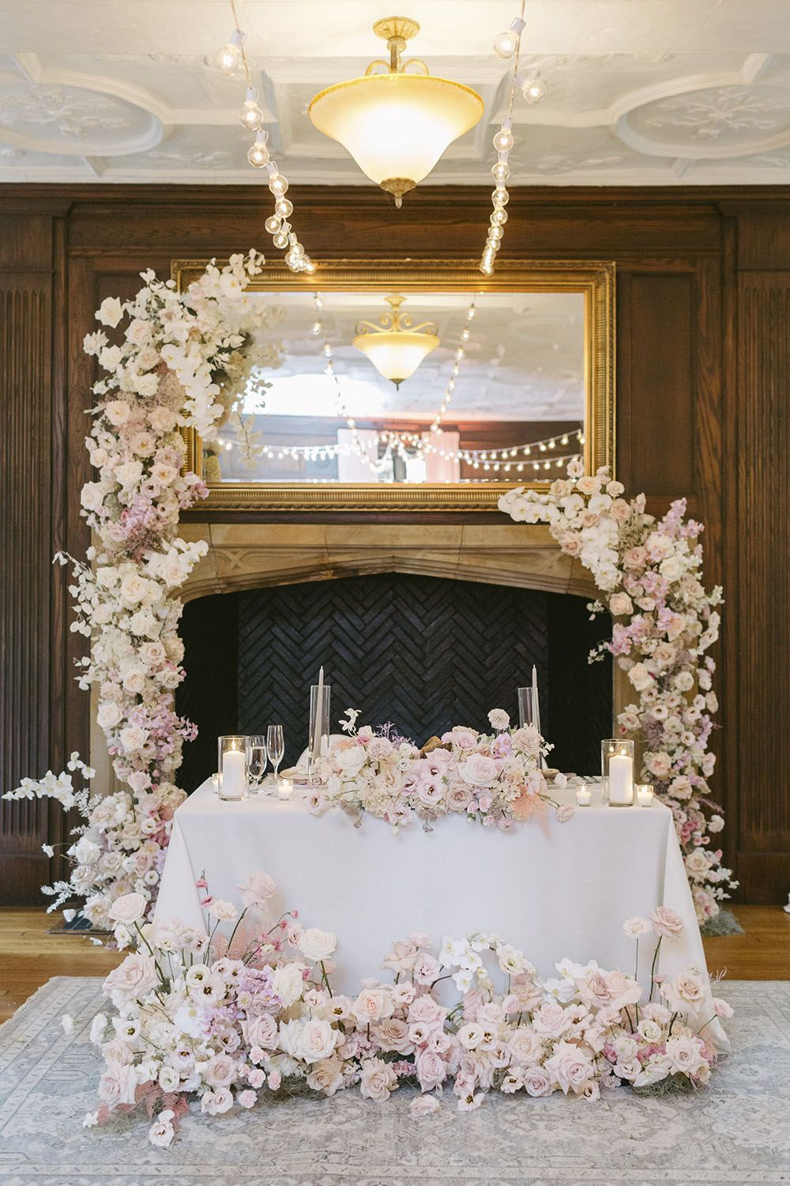
Bride & groom – Table For 2
The bride and groom’s table will be a rectangular table for two, styled to reflect the elegance of the guest tables while incorporating a distinctive statement element
The tabletop will be adorned from side to side with taper and cylinder candles, complemented by a long, medium-sized floral arrangement centered on the table, as well as a larger arrangement at its base, as shown in the reference image
Deconstructed, curved floral columns in two varying heights will be positioned on either side behind the couple, creating a striking and sophisticated frame.
Every detail is thoughtfully curated to harmonize seamlessly with the color palette detailed on slide #2, resulting in a warm, refined, and unforgettable focal point

Slide 23
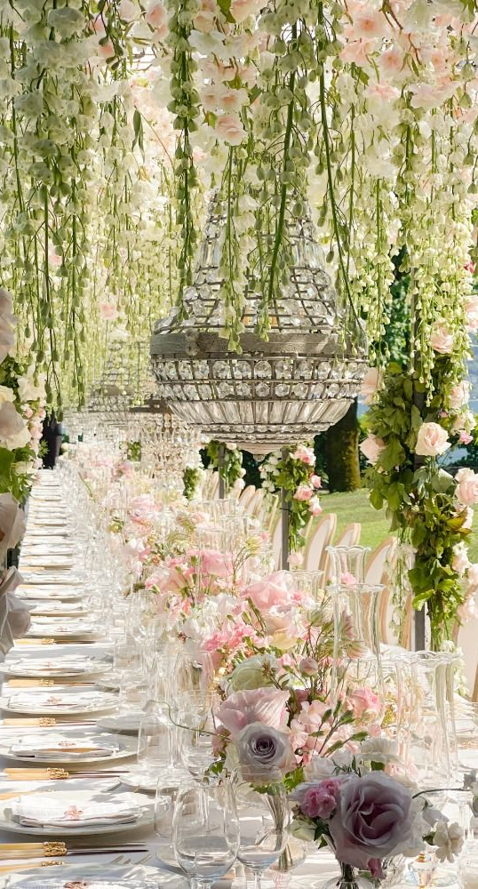
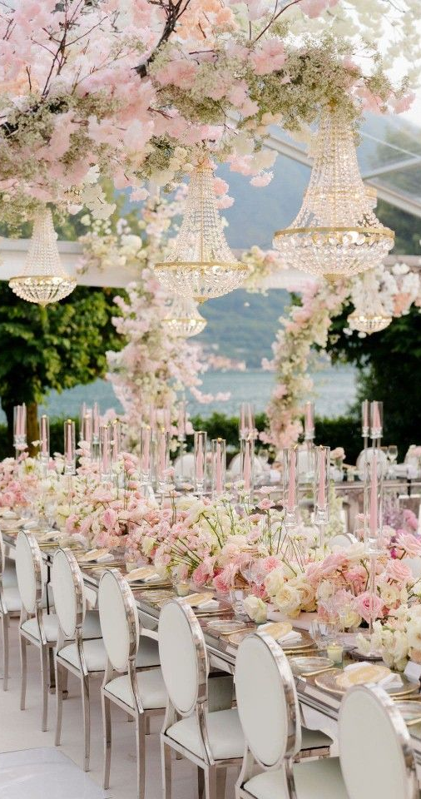
Rectangular Tables – OPTION 1
Rectangular tables (number of guests per side to be confirmed) will be draped in ivory tablecloths and accented with delicate, airy floral arrangements in warm white and soft pink, flowing gracefully along the center to create an elegant and romantic tablescape
These arrangements will be complemented by short crystal taper candles, adding a delicate, luminous touch to the tablescape
The overall décor will reflect and harmonize with the color palette detailed on slide #2

Slide 24
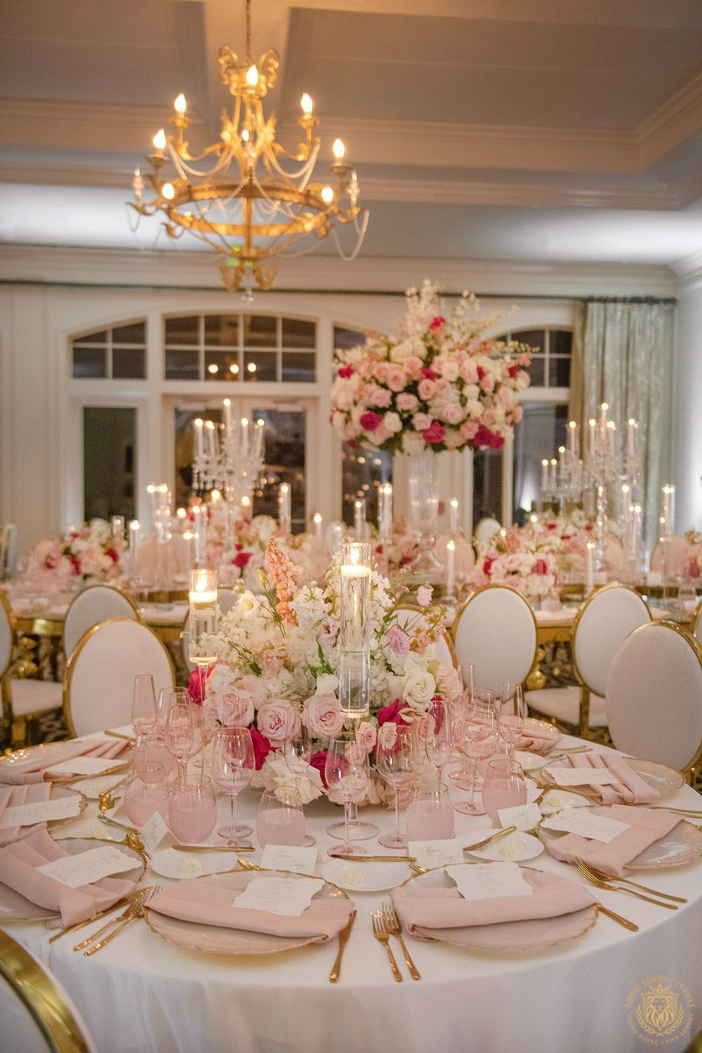
Round Tables Centerpieces – Option 2
For the round table décor, the aesthetic remains light, airy, and romantic. Each table will feature medium-low, rounded floral arrangements, elegantly arranged from end to end in low vases and surrounded by tall crystal taper candle holders. A refined palette of soft pinks, delicate whites, and lush greenery envelops the space, creating a warm, timeless, and effortlessly sophisticated ambiance
NOTE: Real candles at Shangri-la are not allowed we will be using LED ones

Slide 25
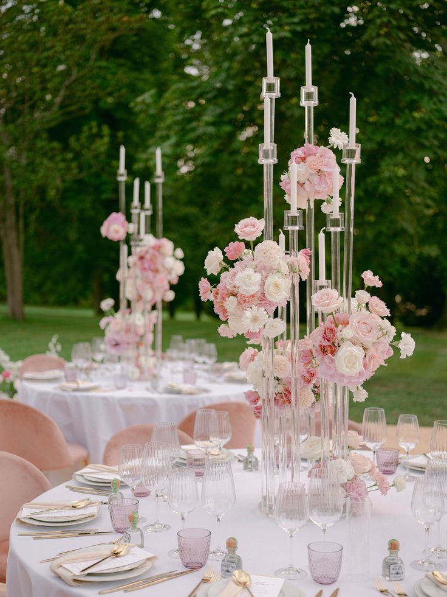
Round Tables Centerpieces – Option 3
Option 3 for the round table centerpieces features a crystal candelabra with LED candles, adorned with an asymmetrical floral arrangement attached exactly as shown in the reference image. A sophisticated palette of light pink, rich tones, and soft whites envelops the space, creating a warm, timeless, and effortlessly luxurious ambiance

Slide 26
RENTALS

Slide 27
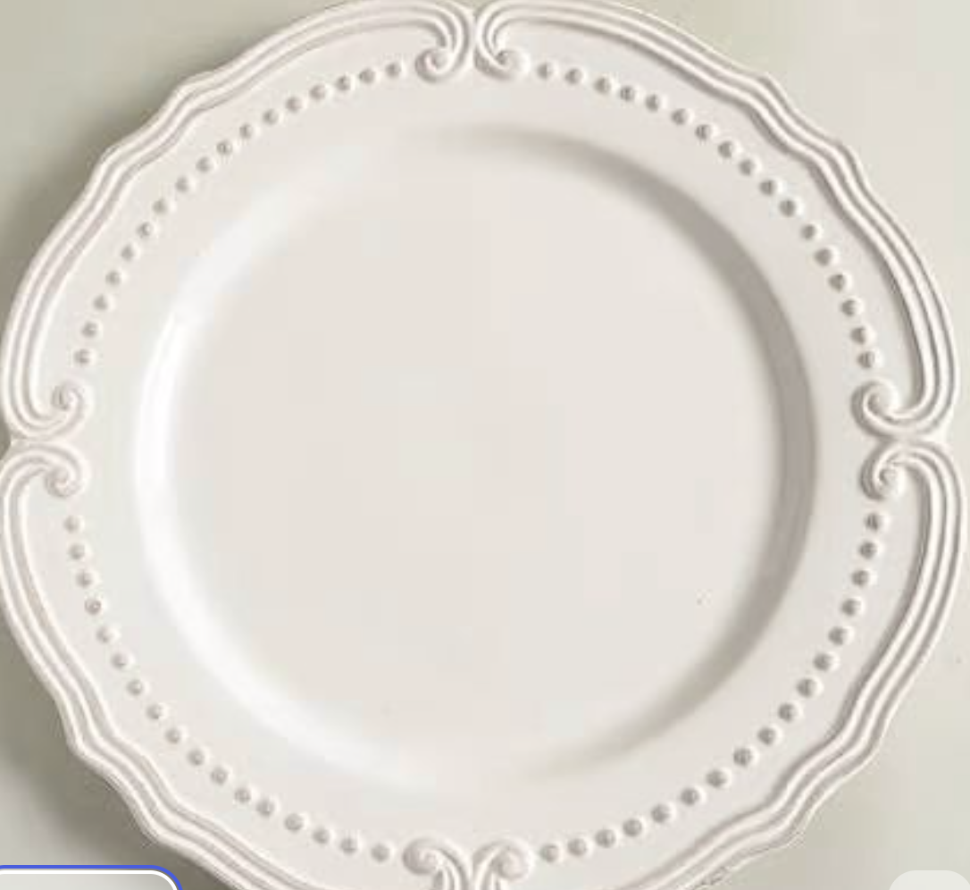
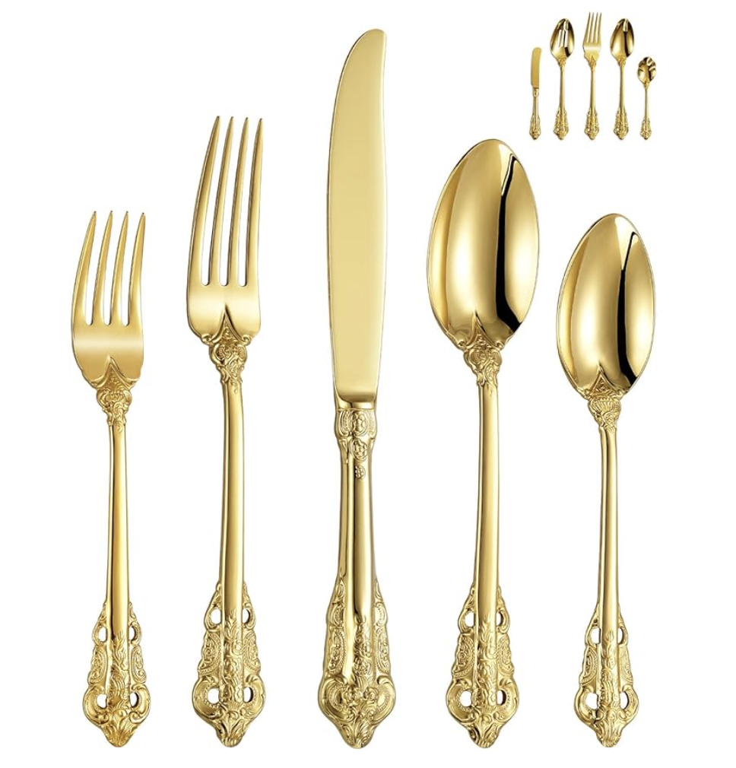
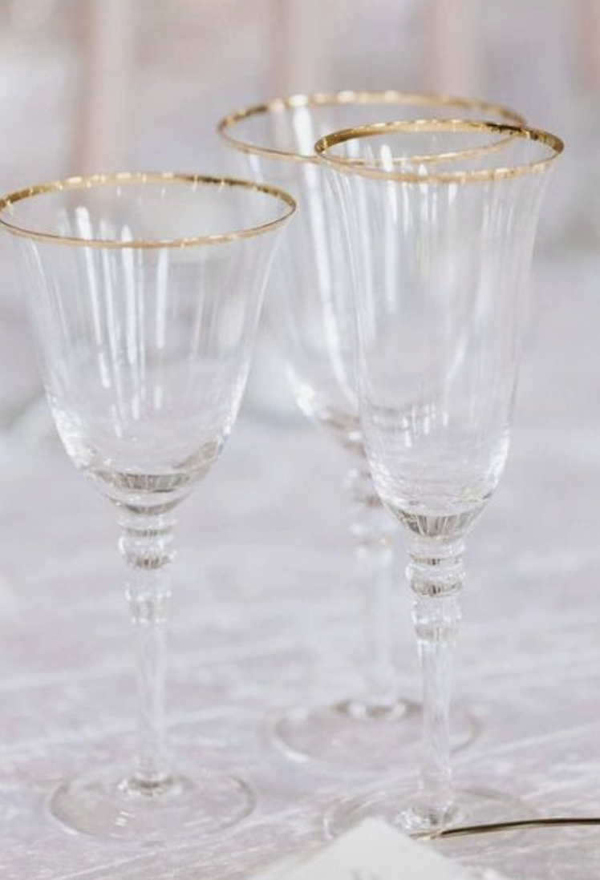
TABLEWARE
Ivory or gold rimmed charger plates will be selected based on rental availability, chosen to match the reference image provided by the bride as closely as possible. Vintage gold flatware will complement the table setting, paired with delicate crystal glassware featuring gold rims and light pink napkins, creating a refined and harmonious tablescape

Slide 28
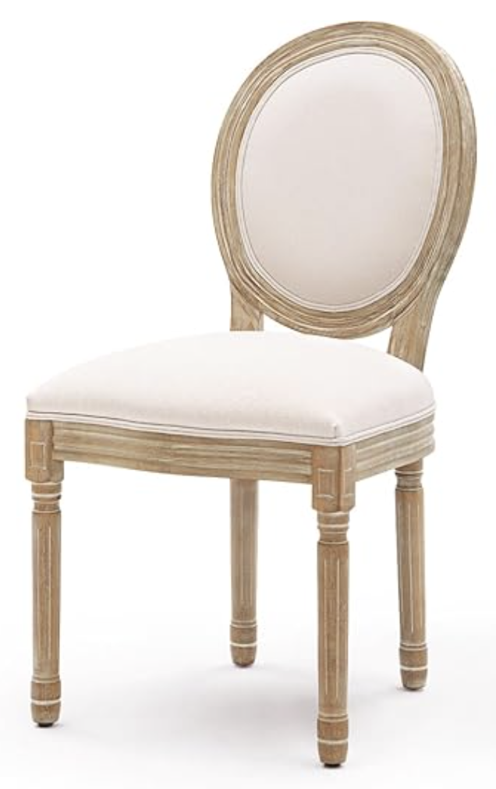
CHAIRS FOR
RECEPTION
WOODEN - Louis Chairs

Slide 29
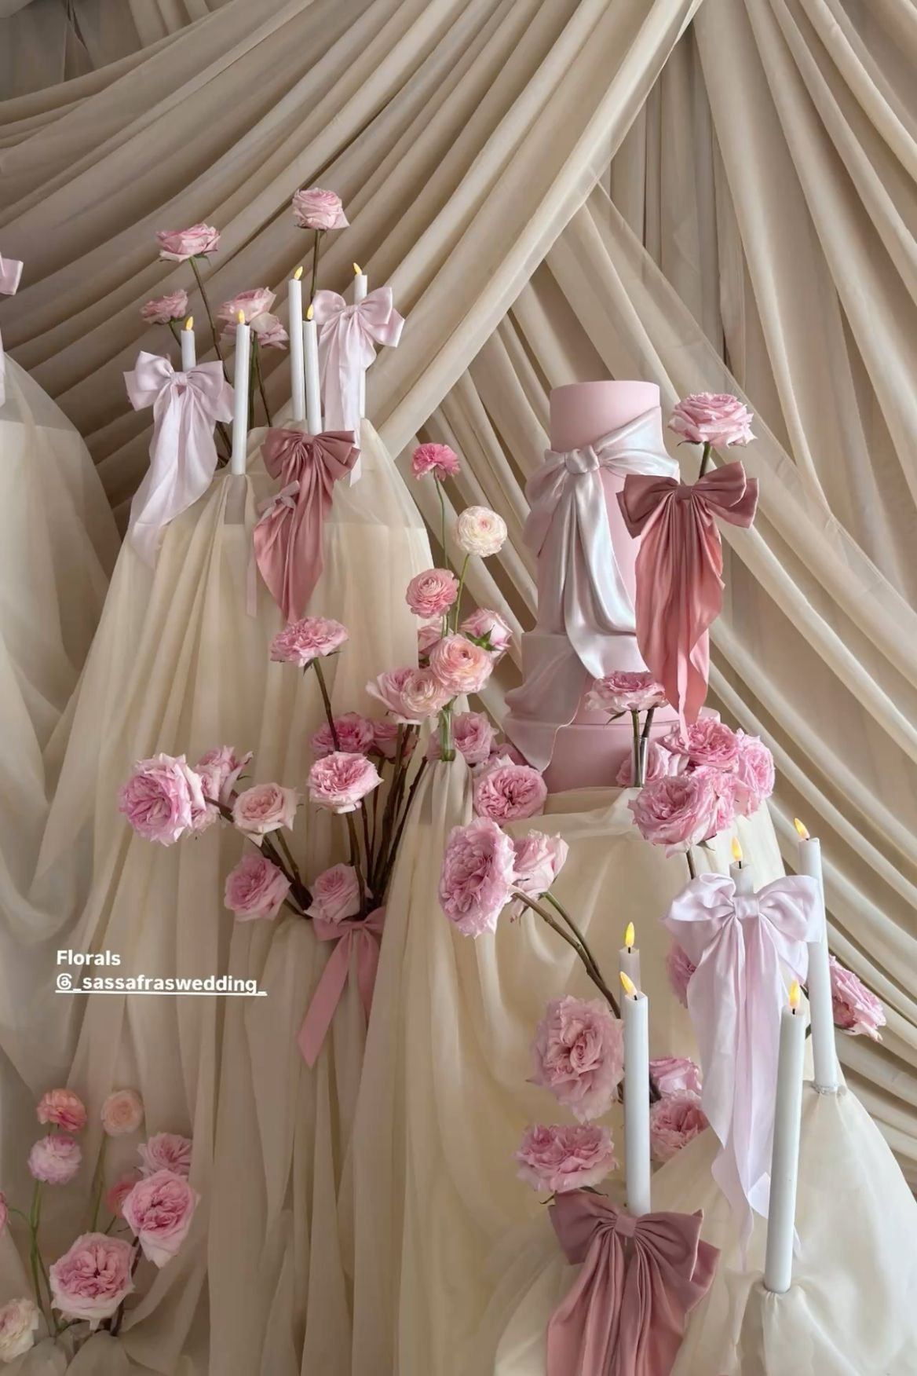
CAKE TABLE
The cake table will be styled with floral arrangements and cascading drapery, as shown in the reference image, harmonizing seamlessly with the overall décor and in keeping with the established color palette

Slide 30
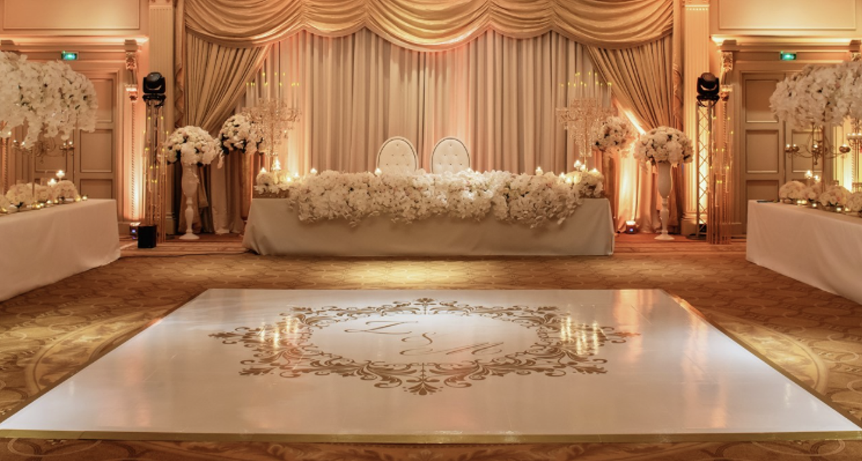
DANCEFLOOR
The dance floor provided by the Shangri-La will be glossy white and wrapped with gold foil, exactly as shown in the reference image, featuring a similar logo with the initials K & S and the date 5.25.2026.

Slide 31
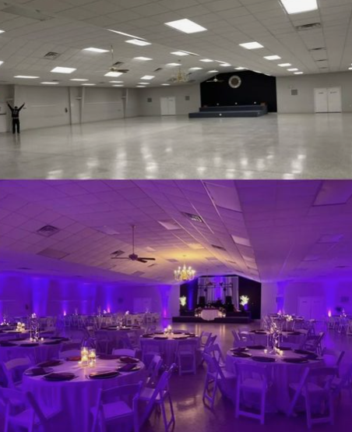
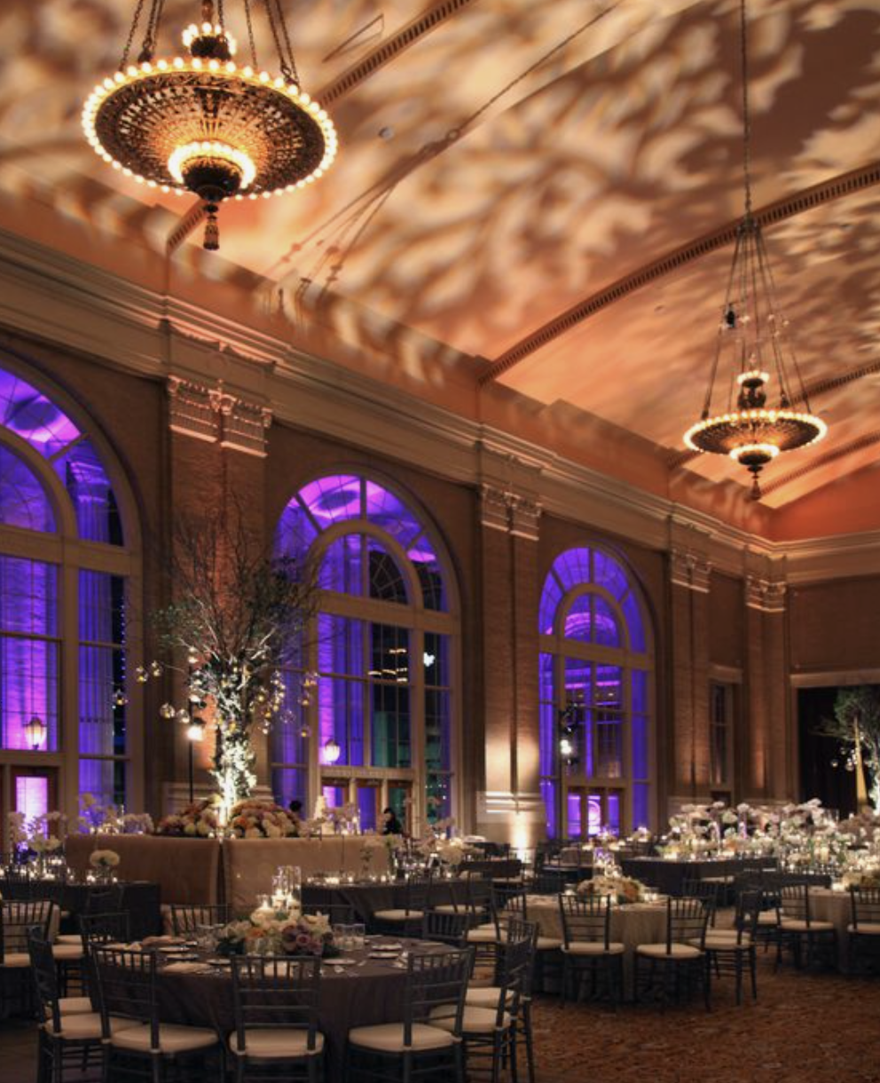
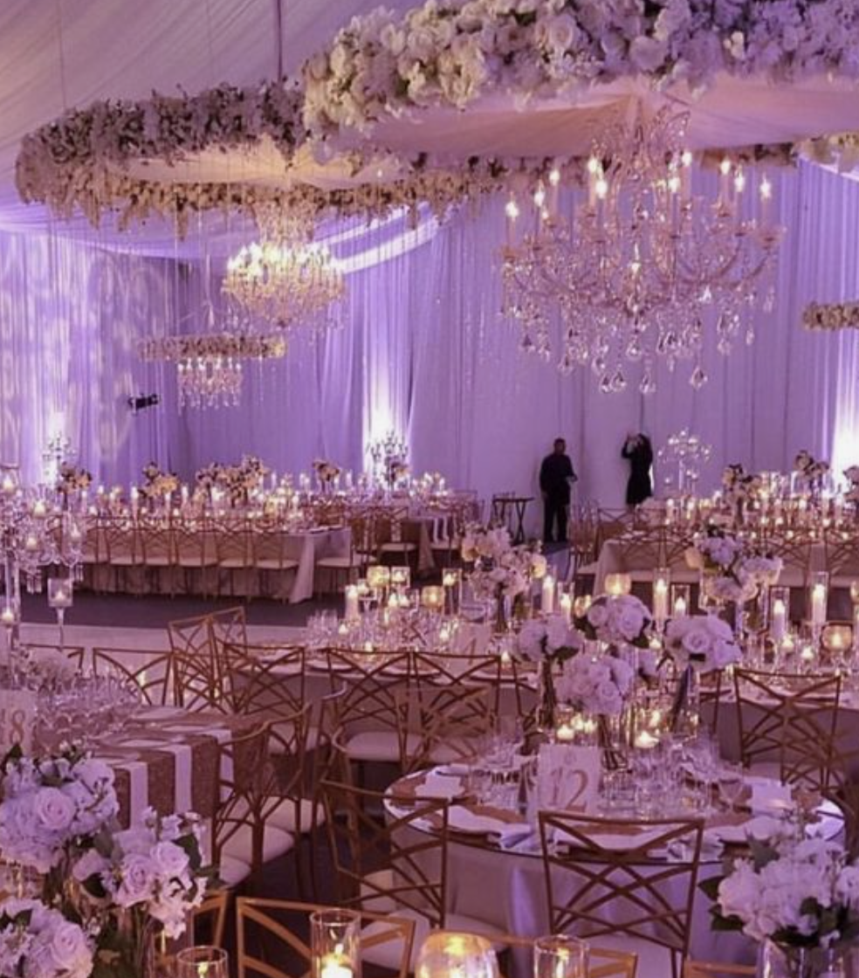
UP LITHING
Audrey’s Note: I highly recommend considering uplighting for your décor. It has a remarkable ability to enhance the overall ambiance by highlighting key elements and adding warmth to the space. Uplighting can truly transform your event, creating a captivating and inviting atmosphere that your guests will love.

Slide 32
FLOOR PLANS

Slide 33
RECEPTION/DINNER SEATING PLAN
The finalized floor plan will be shared upon confirmation of the final guest list and type of tables.

Slide 34
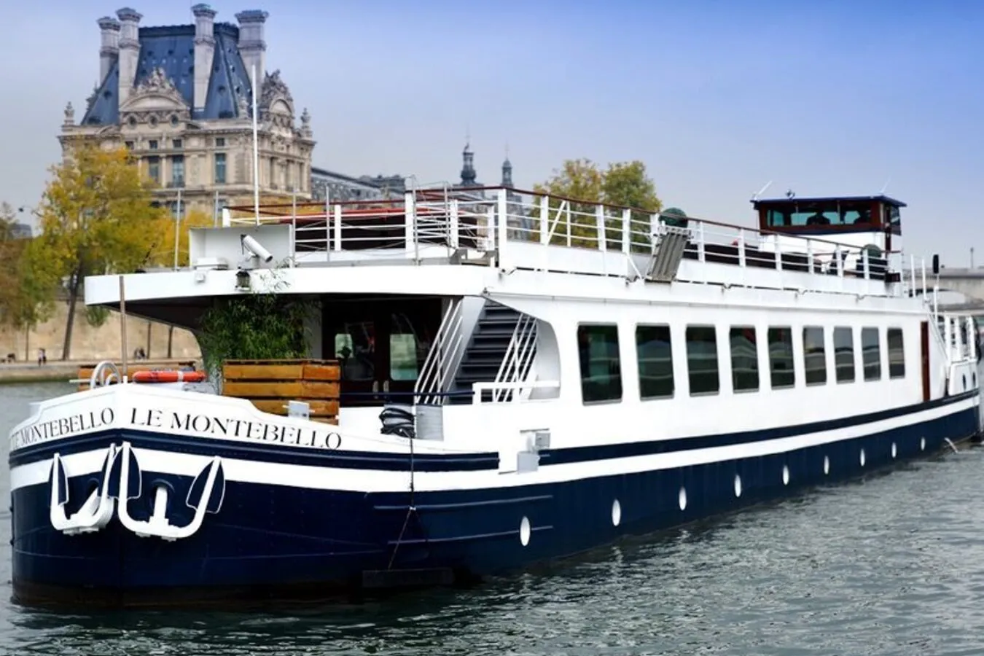
WELCOME DINNER
The welcome dinner will take place at Montebello, Paris.

Slide 35
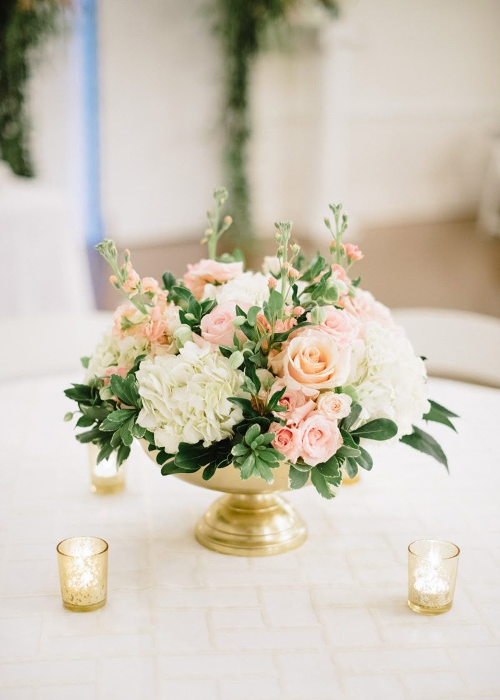
A warm white and light pink floral arrangement will be placed on each table, accompanied by a cluster of small votive candles, creating a light, sophisticated, and effortlessly elegant ambiance

Slide 36
We can’t wait to bring your vision to life!
The concepts (written and images) in this proposal are symbolic of the design inspiration we intend to bring to life for your event. Due to the characteristics of perishable items (flowers), there can be situations that may emerge that are completely out of our control.
To protect the integrity of our creativity, we kindly ask that you do not share the details of this proposal with other vendors bidding for your event. This was made just for you. However, please feel free to share this with your family.

Slide 37
NOTES FOR PLANNER AND FLORIST TEAM ONLY (FRENCH):
Décor de la ceremonie
1 Bouquet de mariée
1 Boutonnière du marié
9 Boutonnières total = pour 7 garcons d’honneur et les 2 papa
5 Bouquet de demoiselles d'honneur
1 Bouquet de flower girls
3 corsages (bracelets) de fleurs pour les 2 mamans et pour la grand mere de la marié
8 tables ronde (jusqu'à 10 invités par table) Nombre final a determiner
2 longue tables rectangulaire de 28 personnes (soit 14 de chaque coté)
6 décor Tables mange debout pour l'heure du cocktail
2 Décor de Bars (1 pour le cocktail - 1 pour la réception/fête)
1 décor pour le welcome sign / panneau de bienvenue
1 décor pour la Table “Welcome” Table
Re disposition des fleurs pour la table du Wedding Cake
1 décor pour la table buffet de dessert + drape blanc comme sur la photo
REHEARSAL DINNER
8 tables – 6-8 petit vase “single flowers” par table – Décor blanc, differente fleurs de saison - Comme sur la photo

